Slide 1
PRESENTATION
Project on
Spare Room
Submitted by
Milan Malla (017-350)
Shuveccha Silwal (017-381)
Sijan Joshi (017-382)

Slide 2
Introduction
Android app based on material design.
01
Location
02
Platform for ad
03
Based on ad hunt
Search for rooms based on specified location.
Platform for users both post ad for room and search for room
Relies on a user posting add and another user searching for posted ads and selecting the room suitable for the user.
04
Easy Searching
05
Save Money
06
Material Design
Eliminate hazardous process of visiting house to house in search for room
Save some money by sharing of the room with multiple room partners.
App based on material design.

Slide 3
Problem
Statement
Budget Problem
compelled to live in unfacilitated room due to low budget.
Spare Room
Compelled to pay rent of the room that is not used.
Busy Lifestyle
People are busy most of the time and they do not have time.

Slide 4

Ads
Search
platform to post ad for their spare room.
help user search for suitable room.
Our
Objective
Sharing
Easy
help other people by sharing their spare room.
get spare and vacant room without going house to house.

Slide 5
Scope and Application
Search Room
Post Room
Easiness
To facilitate user to search for spare and vacant room
post ad for spare and vacant room
Will eliminate a hazardous process of traditional room finding.

Slide 6
THE ABOUT
TECHNICAL FEASIBILITY
Technical Feasibility means whether the project is working in a perfect manner.
Feasibility
Study
OPERATIONAL FEASIBILITY
Operational Feasibility means the project must perform its operation perfectly.
ECONOMIC FEASIBILITY
Economic Feasibility is a term which is related to estimation of cost required for the project.
LEGAL FEASIBILITY
Legal Feasibility means the developing project must be legal

Slide 7
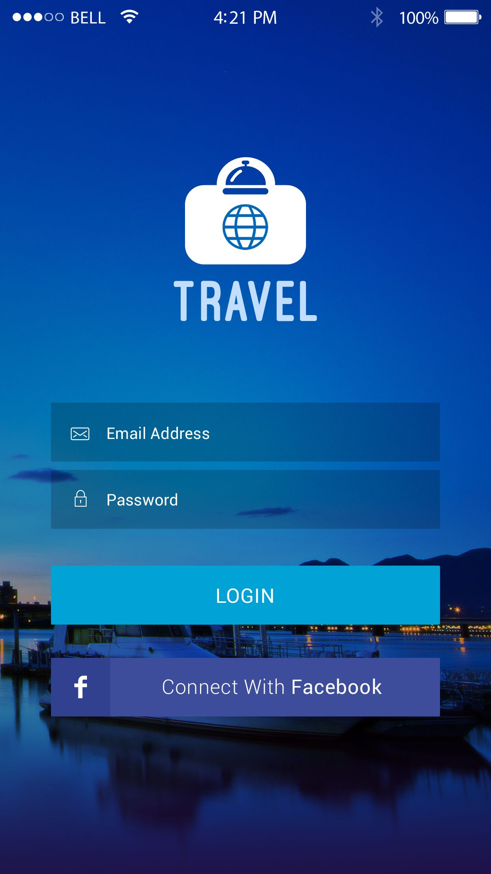

System Design
Our design is mostly going to be based on material design. We are going to use guidelines provided by the material design team.
SpareRoom

Slide 8



Software
Requirements
FLUTTER
FIREBASE
DART
Flutter is open-source UI software development kit created by Google.
Firebase is a mobile and web application development platform developed by Firebase, Inc.
Dart is a client-optimized programming language for apps on multiple platforms.

Slide 9
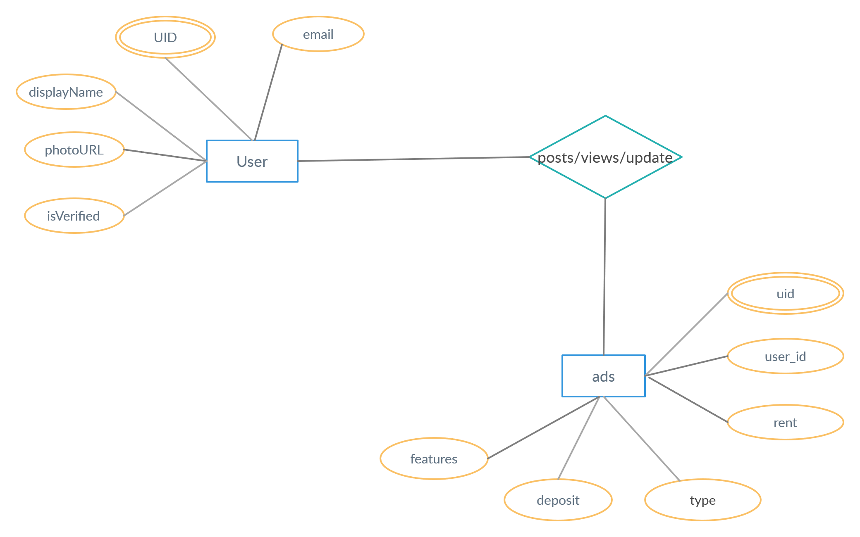
SpareRoom
ER
Diagram

Slide 10
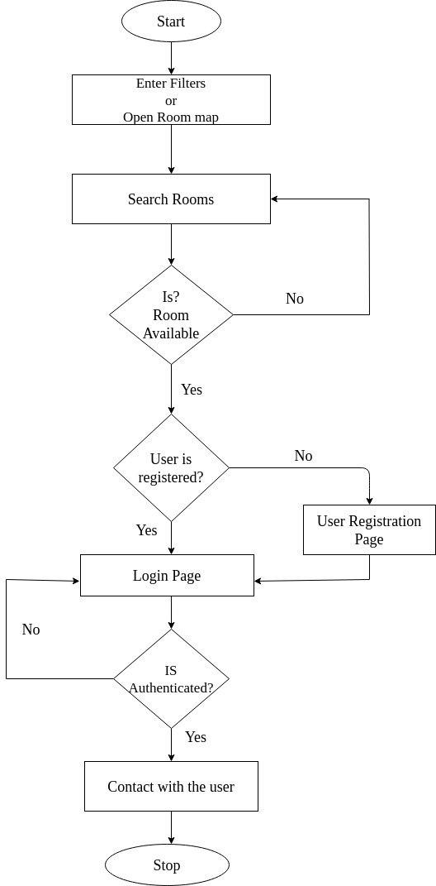
SpareRoom
Flow
Chart

Slide 11
Modules
01
02
03
04
Admin Module
User Module
Ad Module
Message Module
It is the module that has full control over other modules.
The module is responsible for the registration and management of the registered user.
This module manages the ad posted by the corresponding users
This module manages the messages between user about the room.

Slide 12
Work Completed
Connected to backend service
Completed App Design
Completed User Auth
Maps added
Implementation and Discussion
Followings are the work completed, remaining works and output.
Work Remaining
Password Retrieval
Location in ads
Messaging
Expiry date for ad
Search

Slide 13
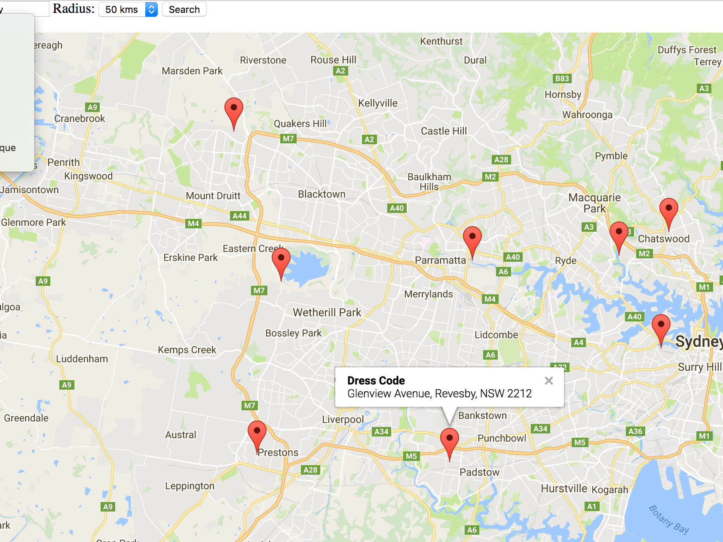
Conclusion
Our “SpareRoom” mobile application is going to be designed in such a way that the user can post ad for spare and vacant room and search for spare and vacant room. This project will mainly focus on facilitating user to freely post ad and eliminate the traditional way of room finding where user has to visit house to house. Flutter is going to be used to make this project as productive as possible. Our main focus will lie on making the user interface as simple as possible. Hence this mobile application will be beneficial for user of any age group.

Slide 14
Thank You
SpareRoom

